Slide 1
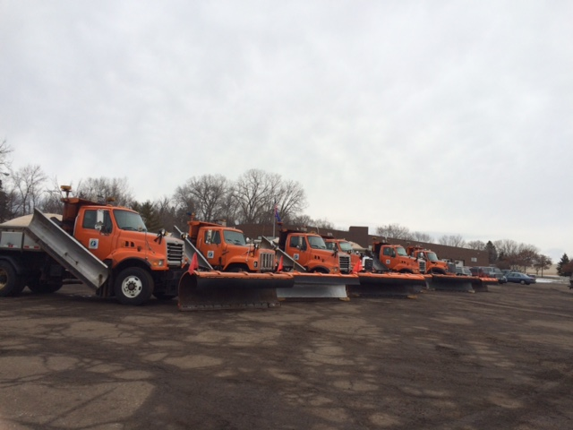
Salt 101

Slide 2
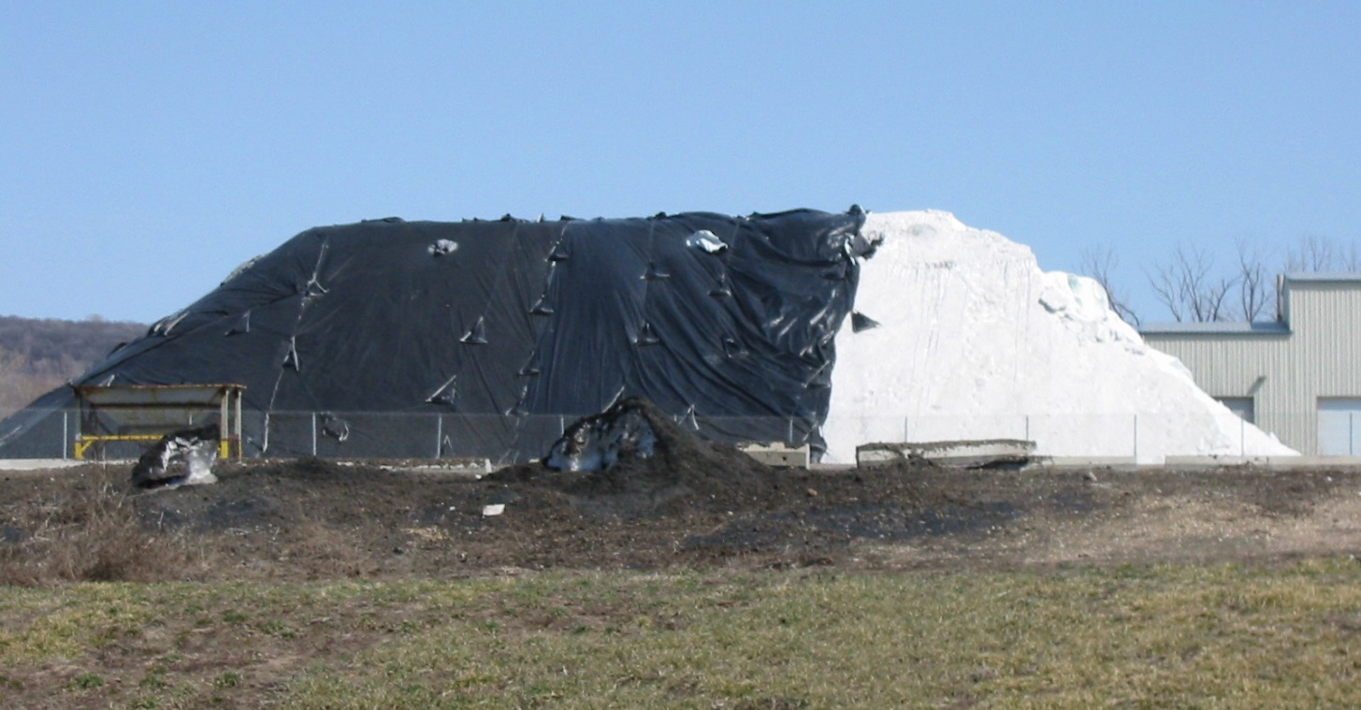
Agenda
How salt works
How salt impacts the environment
MnDOT’s Salt Sustainability Initiative and MDSS

Slide 3
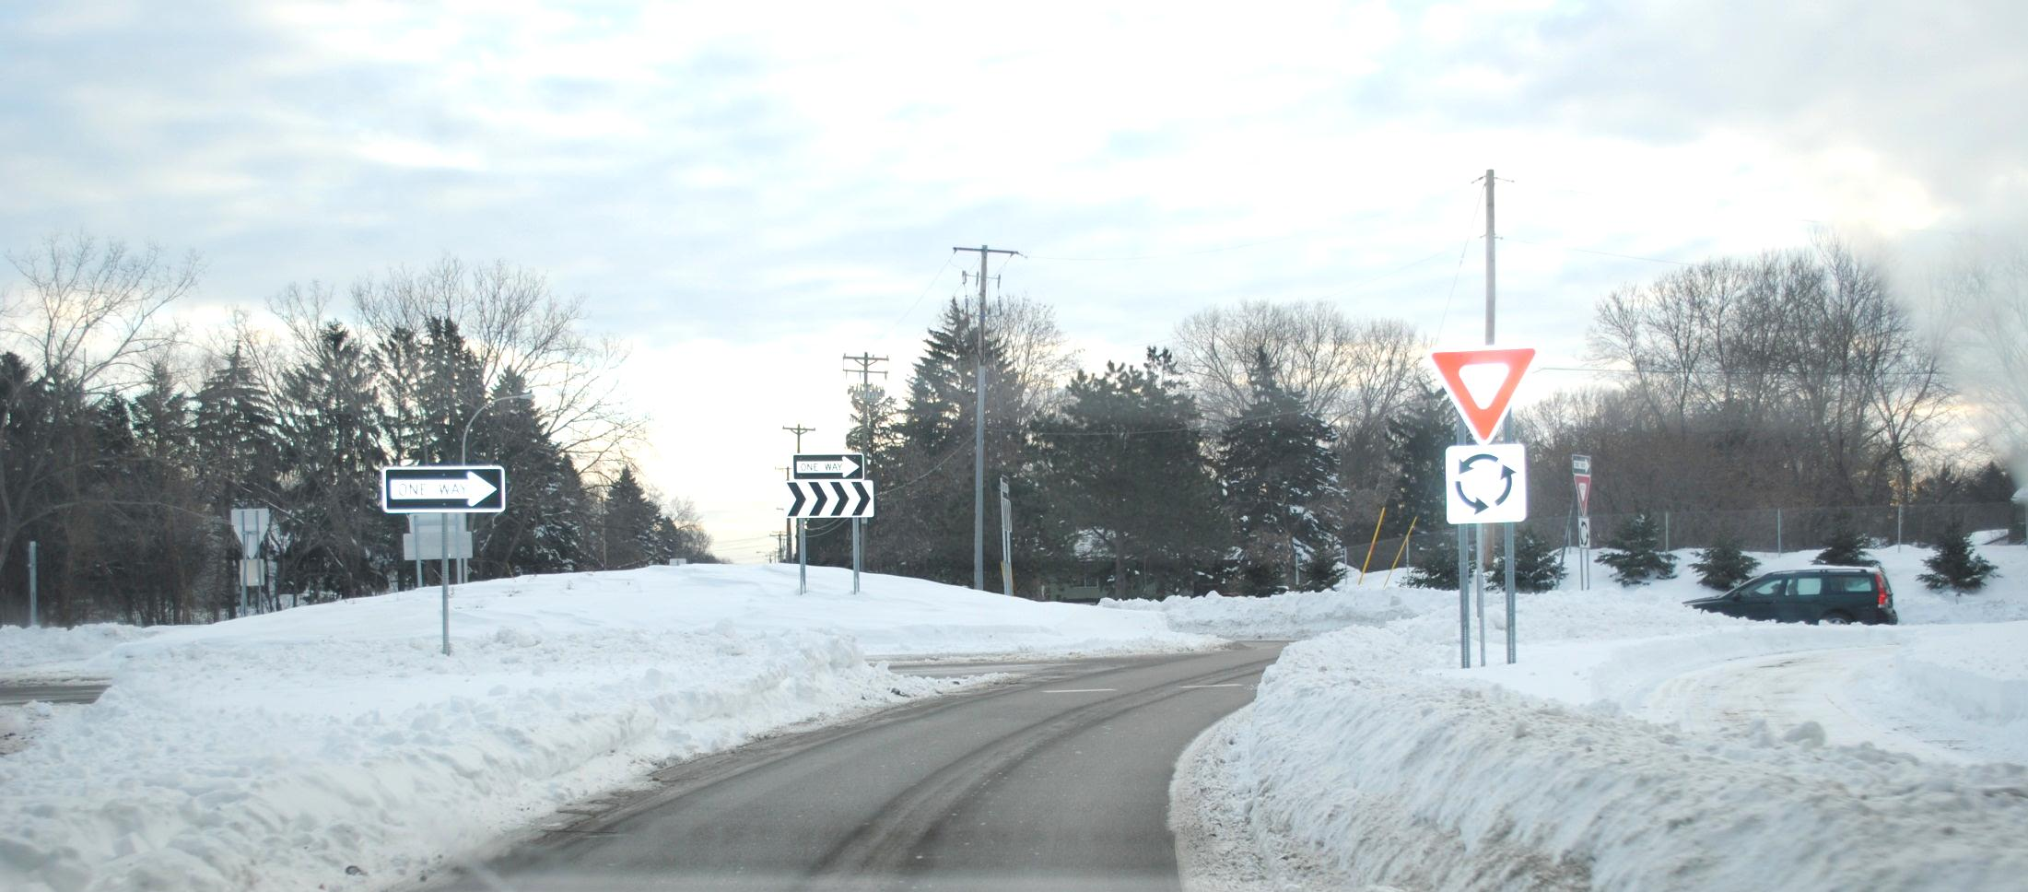
“Snow and ice removal operations is one of the most critical functions of state and local transportation agencies in cold regions.”
Clear Roads

Slide 4
Salt Institute
Plowing and salting can reduce injury crashes by up to 88%
A one day major snowstorm that shuts down roads can cost between $300 and $700 million
Deicing pays for itself within the first 25 minutes after salt is applied

Slide 5
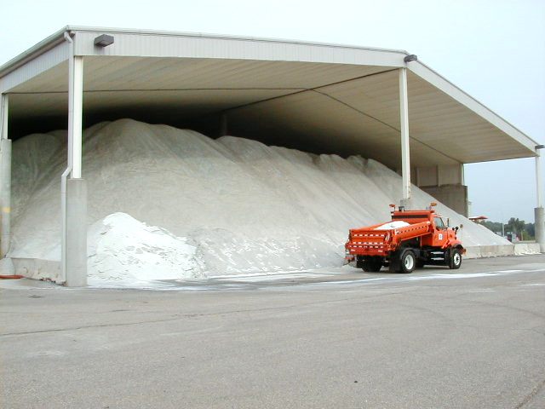
Salt is the most common deicer

Slide 6
Two separate studies found that salt is the most cost effective deicer
Real Performance Characteristics of Deicing Salts
Scott Koefod, Principal Scientist, Cargill Salt Group
Salt Brine Blending to Optimize Deicing and Anti-Icing Performance
Dr. Stephen Druschel, Principal Investigator,
Minnesota State University, Mankato
Notes:
In their studies, both Scott Koefod and Stephen Druschel, determined that salt is the most cost effective deicer available.

Slide 7

How does salt work

Slide 8
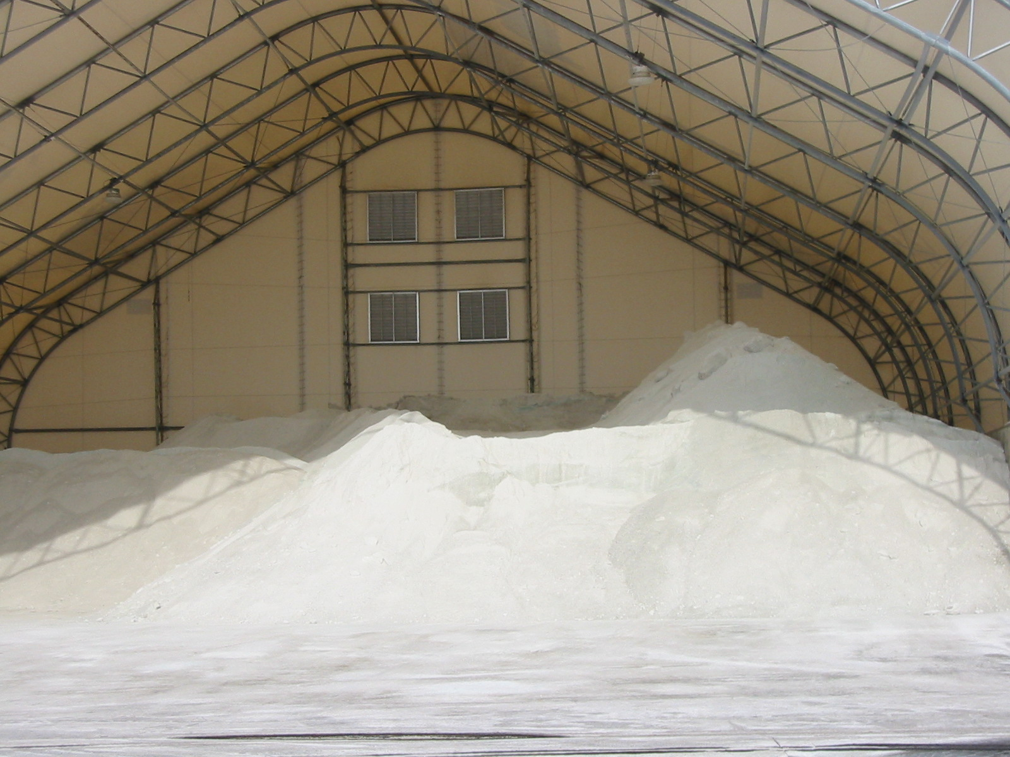
Dry salt won’t break apart ice crystals
Salt only works when it is dissolved - It disassociates (separates into sodium and chloride ions)

Slide 9
Salt
The sodium and chloride ions can then attach to the hydrogens and oxygens in the ice, to destroy the ice crystals
O-
H+
H+
O-
H+
H+
Cl-
N+

Slide 10
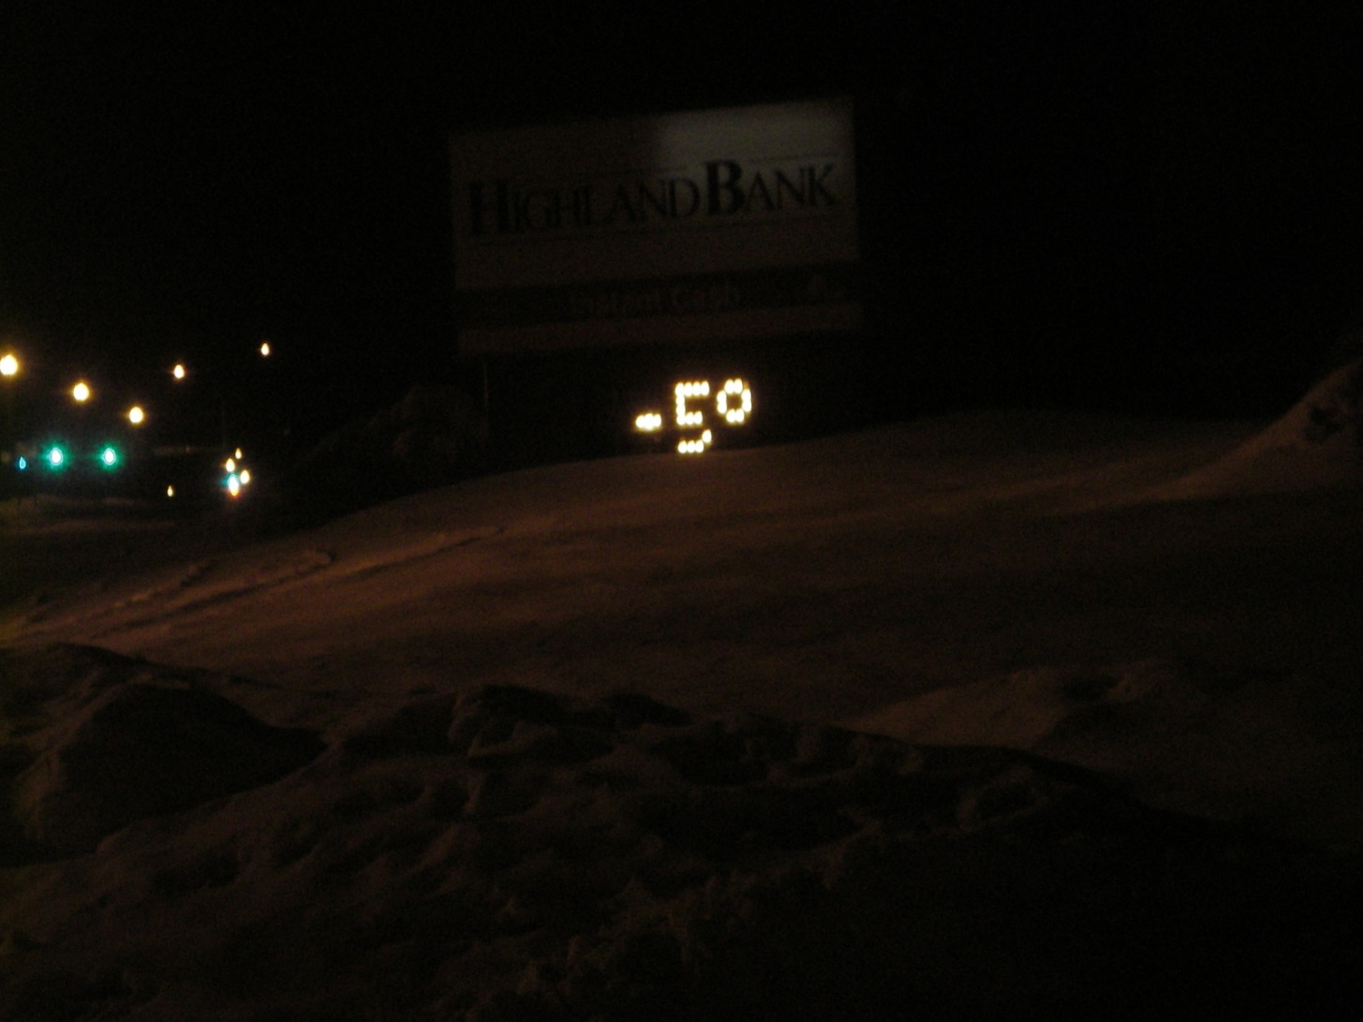
As the temperature drops, the ability of the sodium and chloride ions to break apart ice crystals diminishes rapidly

Slide 11
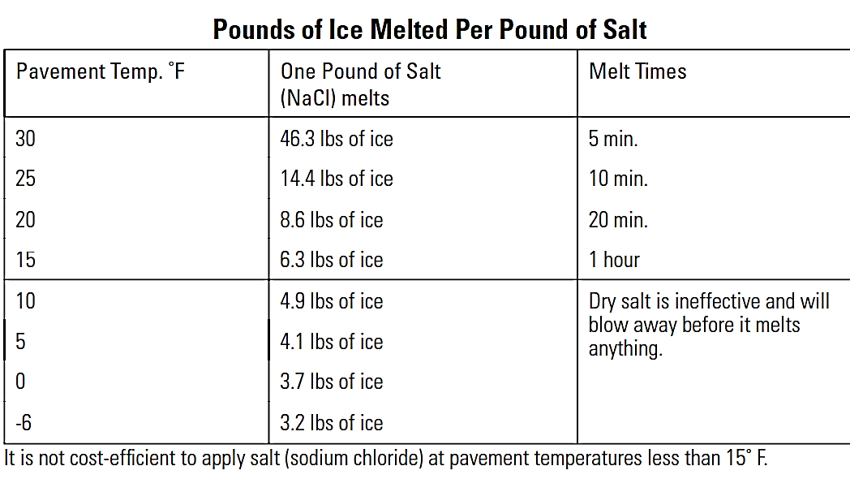
Speed of Melting is very temperature dependent
Notes:
11

Slide 12
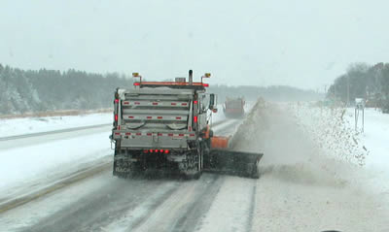
Dilution
Salt is most effective at a 23.3% solution
When melting occurs, the solution on the roadway becomes diluted

Slide 13
Dilution
To minimize the dilution, snow must be plowed off the road before applying salt

Slide 14
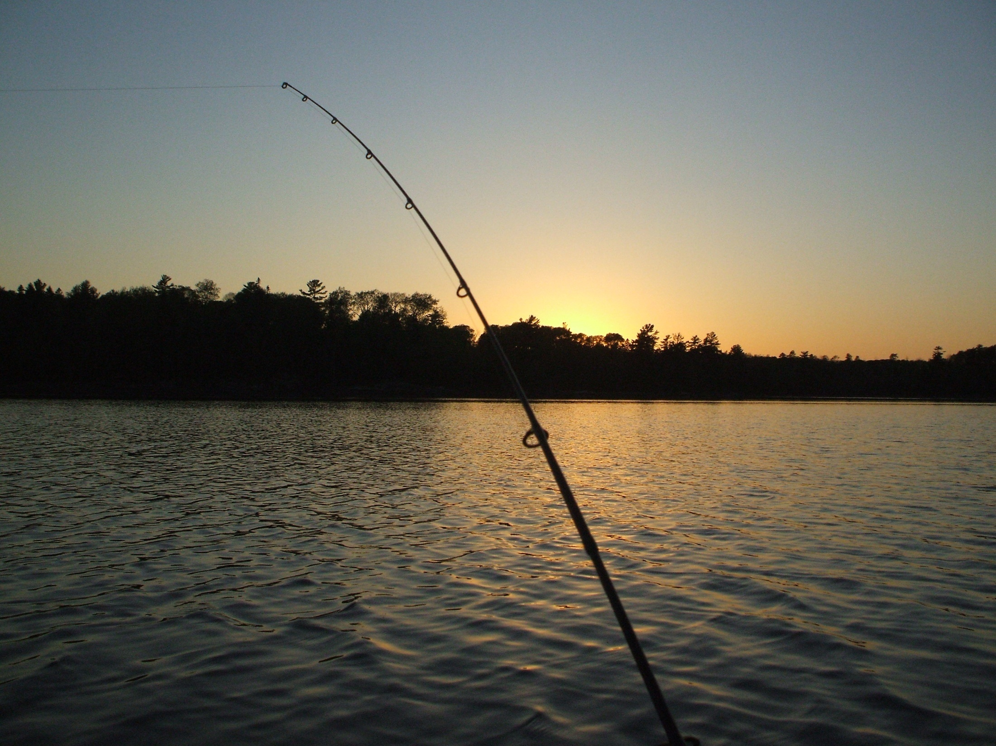
How sodium and chloride affect the environment

Slide 15
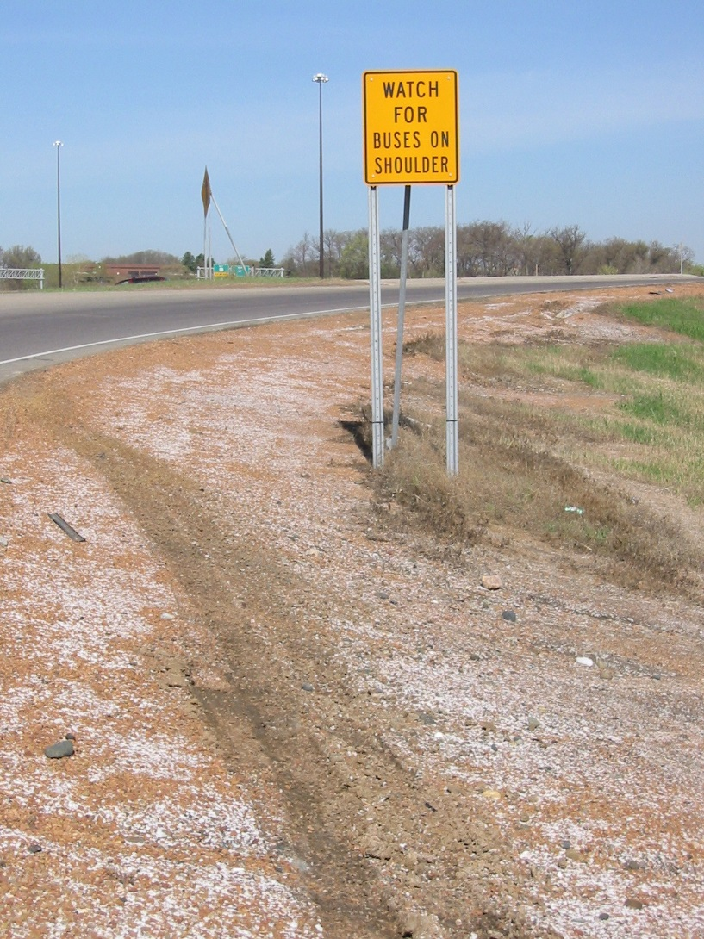
Sodium
The sodium ion primarily causes problems in roadside soils
Excess amounts of sodium can adversely impact soil structure, making plant growth difficult

Slide 16

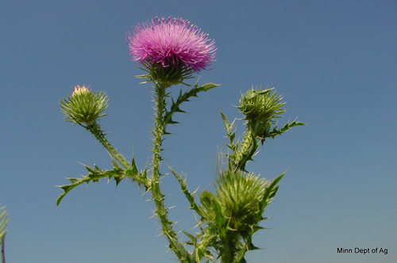
Sodium
Reduces oxygen availability in the root zone
Restricts root growth and seed emergence
Increases erosion
Creates an environment where invasive species can thrive

Slide 17
Chloride
The reason salt is so effective is also the reason it’s harmful to the water
The bond between the chloride and the hydrogen ions is not easily broken
O-
H+
H+
O-
H+
H+
Cl-
N+

Slide 18
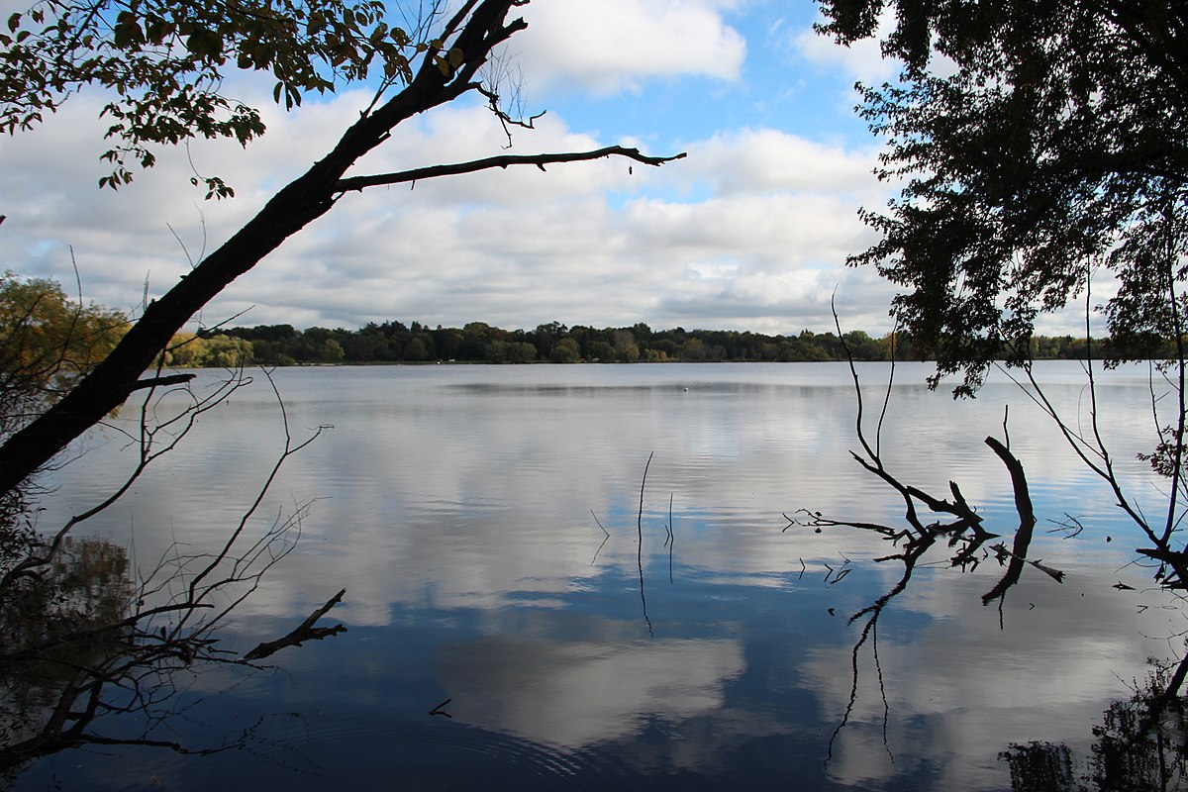
Chlorides in water
Chlorides do not break down, they stay attached to the water molecules
There is no practical way to remove chloride from water
The chloride continues to accumulate

Slide 19
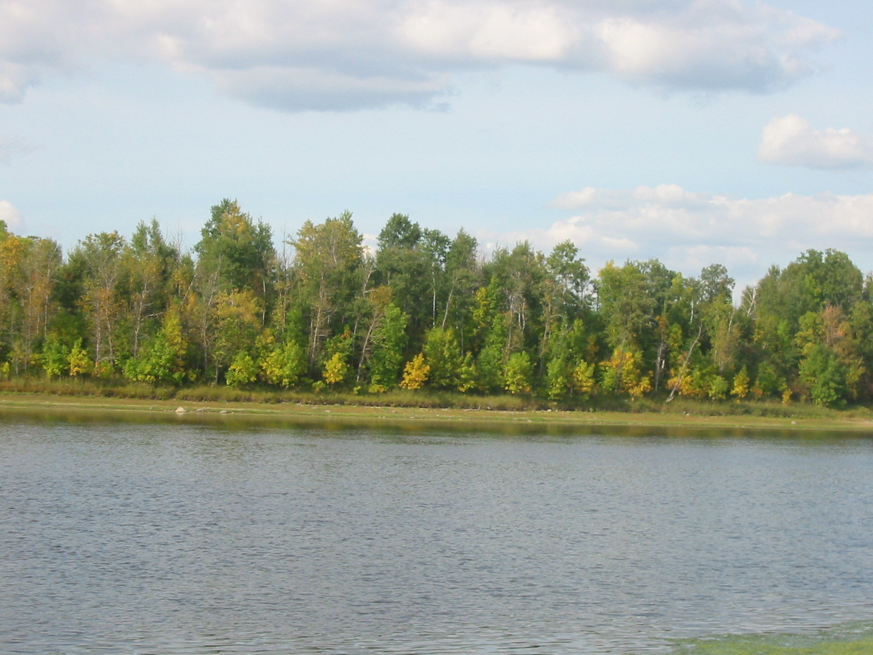
Minnesota Waters
MPCA 2016 Draft list of chloride impaired waters
47 water bodies listed for chloride

Slide 20
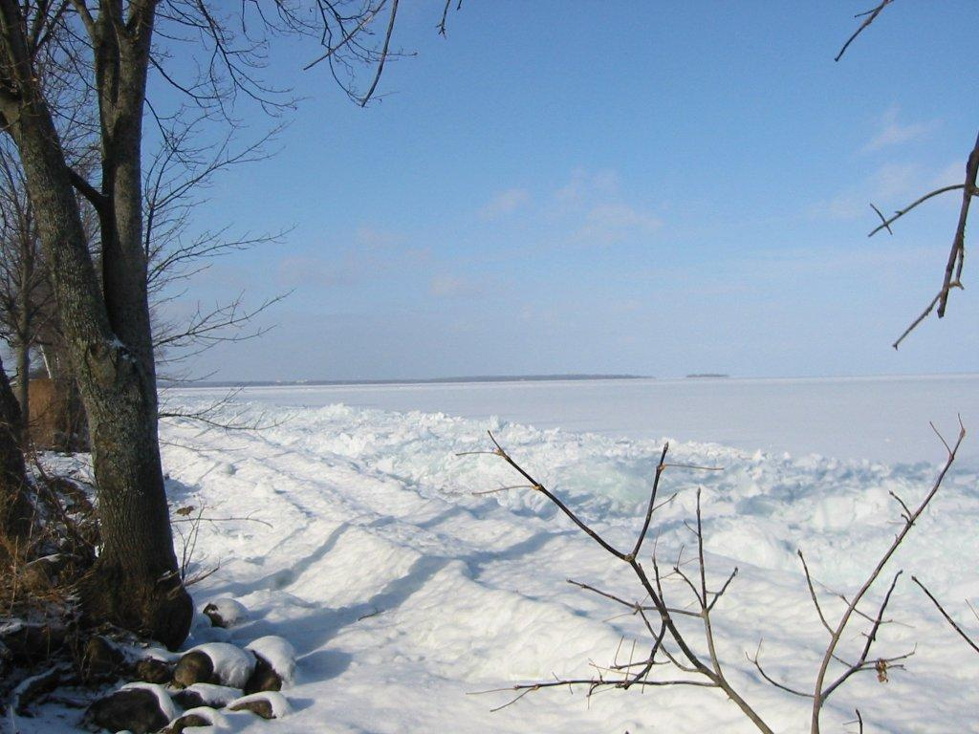
Impaired means a pollutant exceeds the federal standard

Slide 21
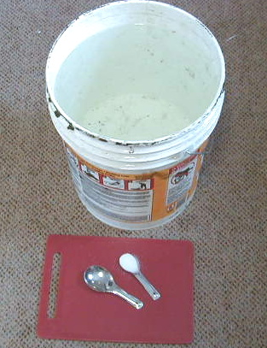
Chronic Standard for Chloride
230 mg/L
~ 1 teaspoon salt in 5 gallons of water

Slide 22
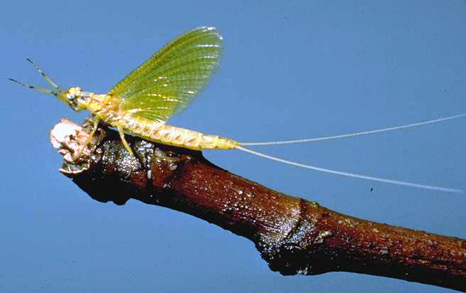
Chronic conditions
Over time organisms don’t thrive, may die young, limited reproduction
Photo by J. W. Stewart

Slide 23
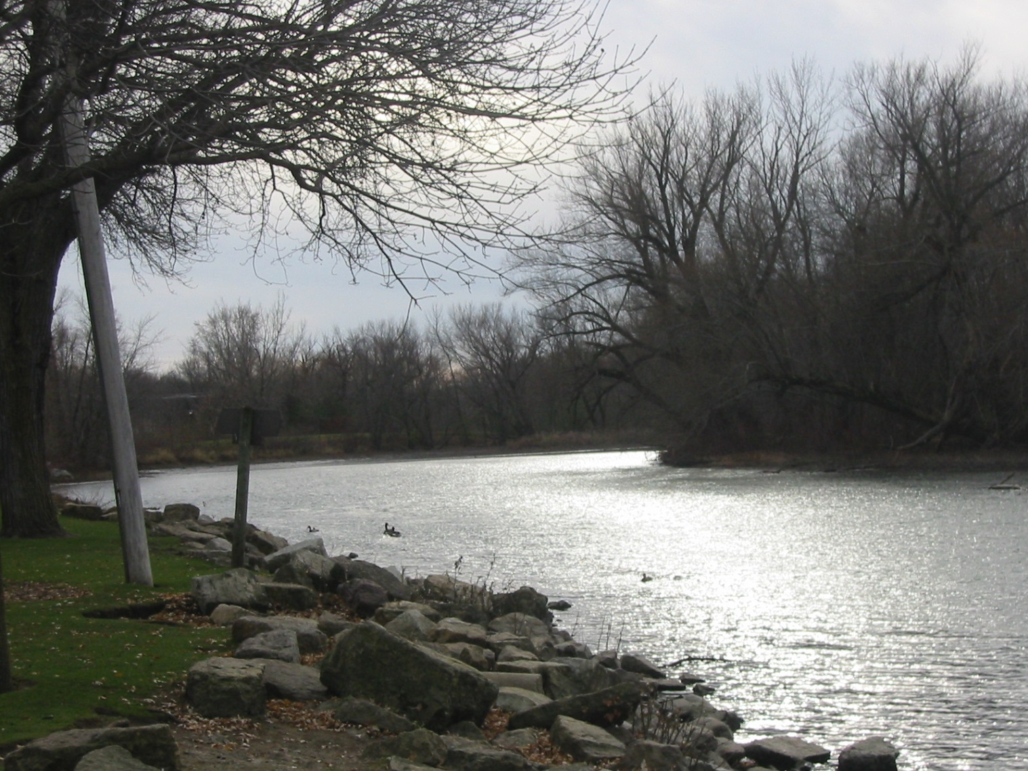
Acute standard
860 mg/L
About 1 tablespoon salt in 5 gallons

Slide 24
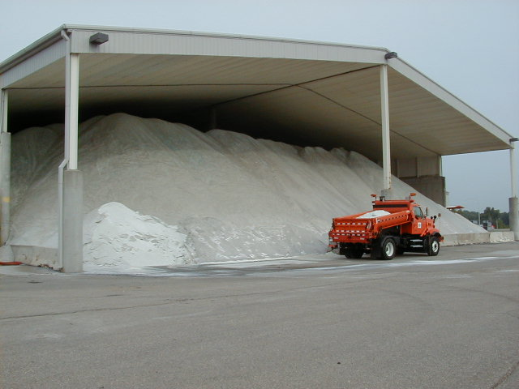
It is estimated that 350,000 tons of salt is used in Metro area every winter
(Number based on salt purchased)
Novotny, Sander, Mohseni and Stefan, 2008

Slide 25
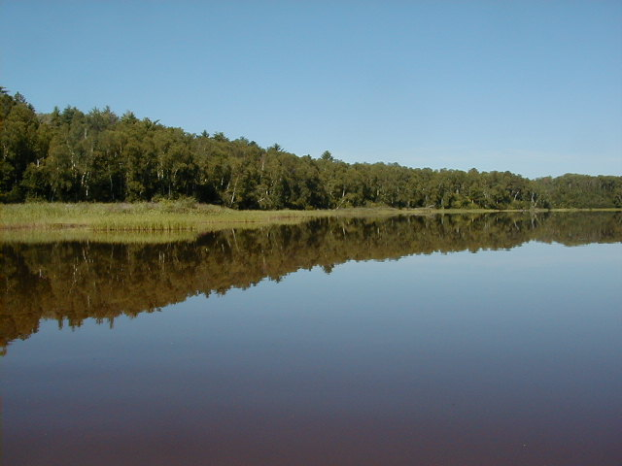
~30% of the chloride is leaving via the Mississippi River
~70% of the chloride applied in the Metro area is unaccounted for
Novotny, Sander, Mohseni, and Stefan 2008

Slide 26
Chloride in lakes
Chloride can affect the spring and fall turnover of lakes
Turnover is important, it brings oxygen to the bottom of the lake
Mixed water
Heavy with chloride
Won’t mix

Slide 27
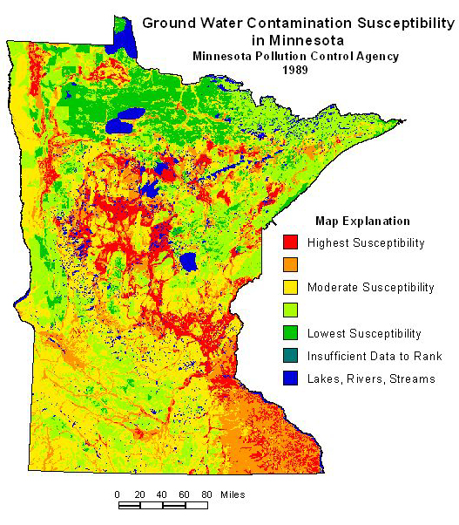
Chloride in groundwater
A USGS study showed high levels of chloride in Metro groundwater
Groundwater supplies 75% of Minnesota’s drinking water
Photo: MN DNR

Slide 28
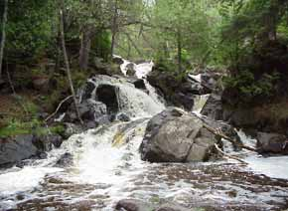
Outside the Metro Area
Chloride concerns aren’t restricted the Twin Cities Metro Area
Tischer Creek in Duluth experiences spikes in chloride during spring melt

Slide 29
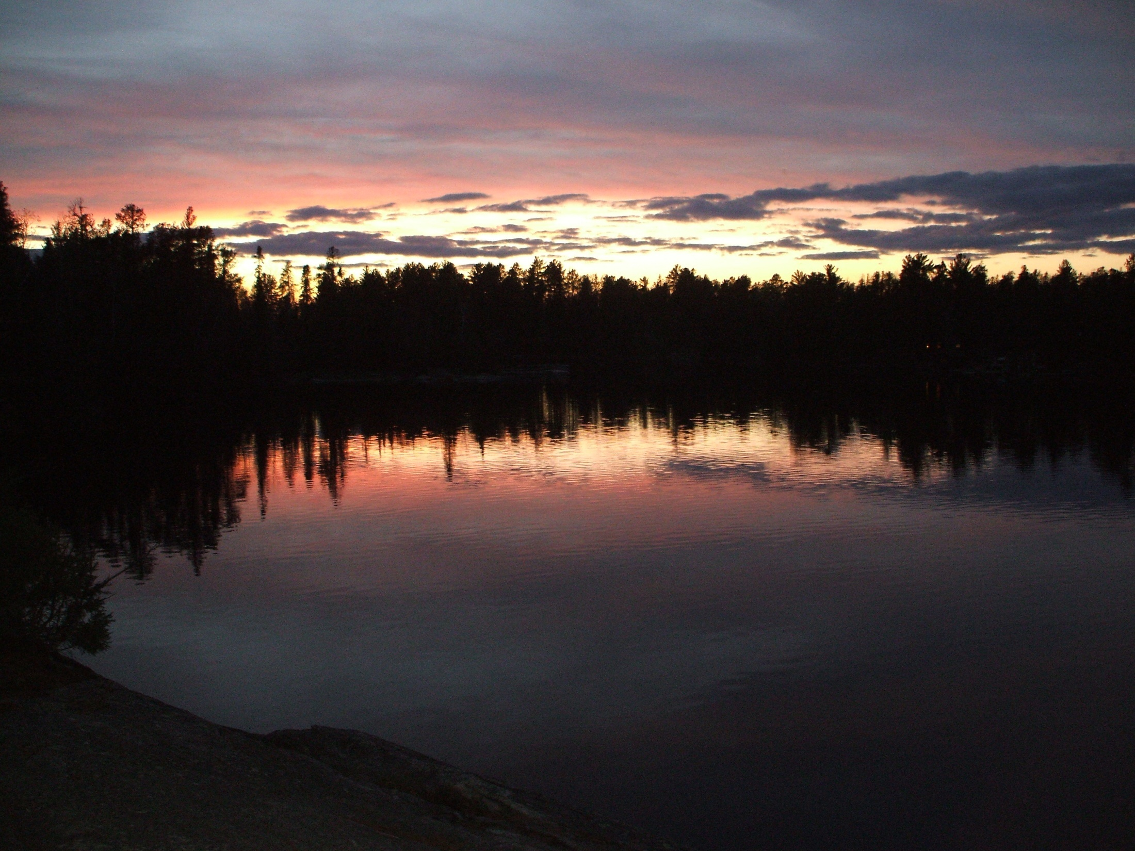
MnDOT’s Salt Sustainability Initiative

Slide 30
MnDOT Salt Sustainability Plan
Target: Within 5 years salt usage will be less than 10% above MDSS recommendations
Focus on 4-R’s
  Right material
  Right amount
  Right place
  Right time
Training
Post-storm meetings
Calibration
New technology/materials

